Slide 1
Agile Software Development
Prof. Dr. Dirk Riehle
Friedrich-Alexander University Erlangen-Nürnberg
AMOS E01
Licensed under CC BY 4.0 International
Notes:
It is Friedrich-Alexander University Erlangen-Nürnberg – FAU, in short.
Corporate identity wants us to say “Friedrich-Alexander University”.

Slide 2
Agenda
Software developer
Sprint planning
Day planning
Programming principles
Code ownership
Technical debt
Refactoring

Slide 3
1. Software Developer

Slide 4
Software Development Team (Recap)
The software development team
  Holds overall responsibility for delivering working software
    That provides the features the team committed to delivering

Slide 5
Primary Role Responsibilities (Recap)
Engineering Management
  Who?
    By when?
Software Development
  How?
    How fast?
Quality Assurance
  Releasable?
    Good enough?

Slide 6
Traditional to Scrum Role Mapping (Recap)
Traditional
Scrum
Product Manager
Product Owner
Engineering Manager
Software Developer
Software Developer
Scrum Master
QA Engineer

Slide 7
2. Sprint Planning

Slide 8
Sprint Planning (Practices)
Break Down Features into Tasks
  Responsible: Developers
  Artifacts: Feature, feature board, tasks
  Collaborators: Developers
Track Feature Implementation
  Responsible: Developers
  Artifacts: Sprint backlog, task board
  Collaborators: Developers

Slide 9
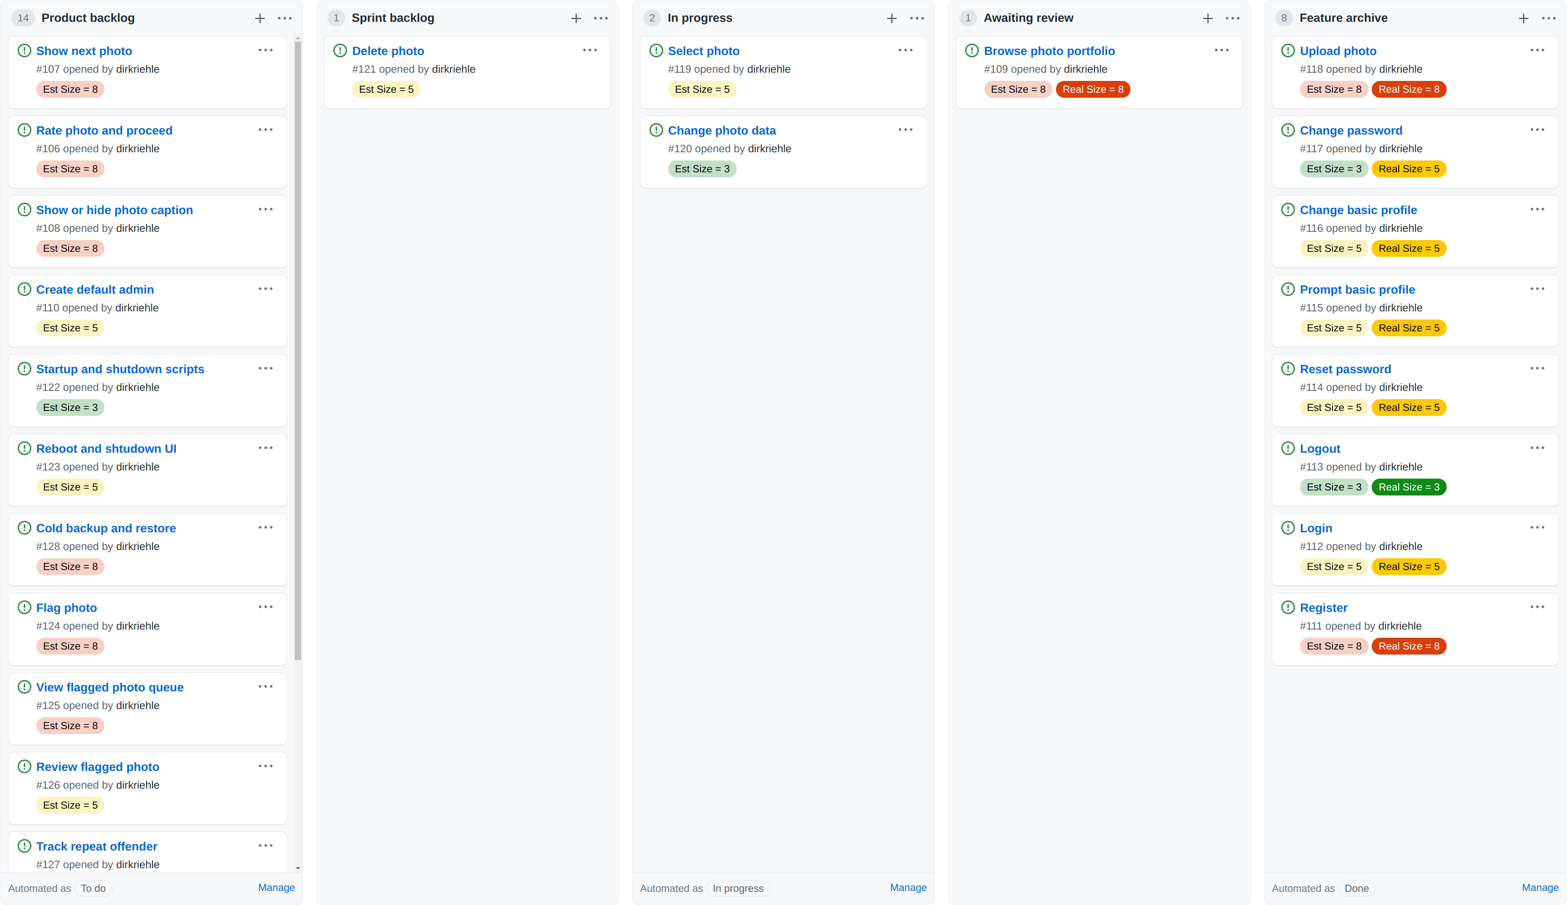

Slide 10
Feature Board (Artifact)
Feature board (a.k.a. project board)
  Visualizes the progress towards finishing features and the current sprint
  Shows for each feature the progress of implementation
  May break down work into hours

Slide 11
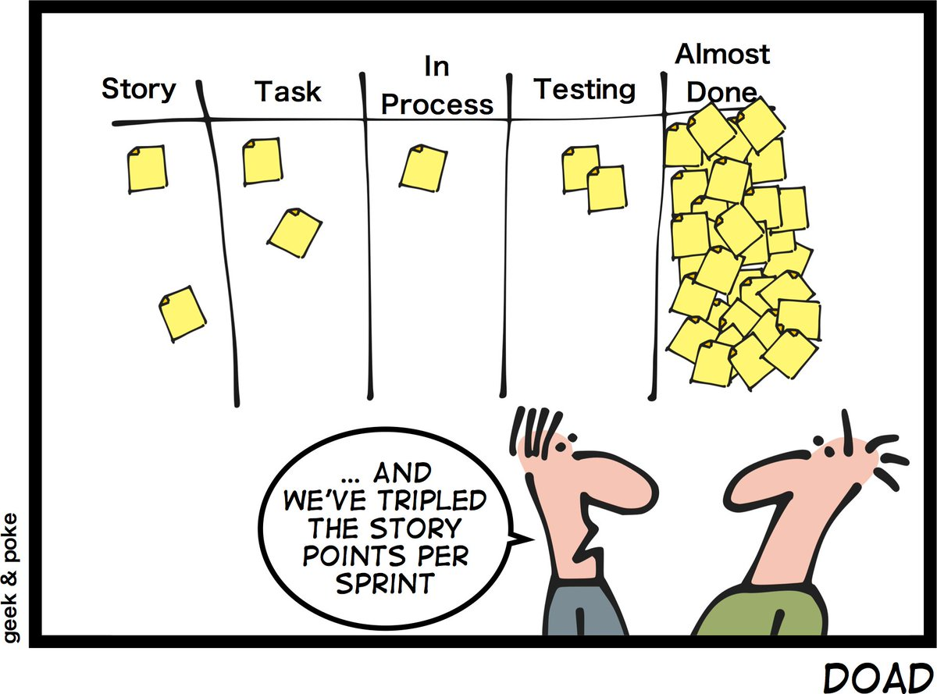
Definition of Almost Done

Slide 12
3. Day Planning

Slide 13
Day Planning (Practices)
Perform Daily Scrum
  Responsible: Scrum master
  Artifacts: Impediment backlog
  Collaborators: Developers

Slide 14
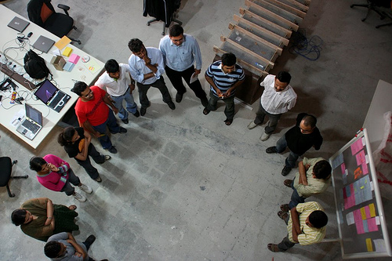

Slide 15
Daily Scrum
Daily Scrum
  Is a daily status meeting to sync on problems and upcoming work
  Is to be kept as short as possible (a.k.a. daily stand-up meeting)
Other properties
  “Pigs” are mandatory, “chicken” are optional, only “pigs” may speak
  Provides only updates, everyone may only speak once
  No discussions allowed, any discussions are taken off-line
  Scrum master to follow-up on problems
Questions asked
  What did you do yesterday?
  What will you be doing today?
  What obstacles are in your way?

Slide 16
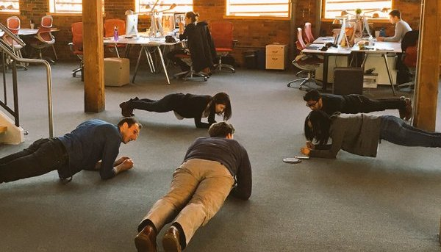
Plank Meetings

Slide 17
4. Programming Principles

Slide 18
General Principles 1 / 4
KISS
(Keep It Simple, Silly)

Slide 19
General Principles 2 / 4
YAGNI
(You Ain’t Gonna Need It)

Slide 20
General Principles 3 / 4
DRY
(Don’t Repeat Yourself)

Slide 21
General Principles 4 / 4
Make it run
Make it right
Make it fast

Slide 22
5. Code Ownership

Slide 23
Collective Code Ownership (Practice)
Own code collectively
  Responsible: Development team
  Artifacts: Source code
  Collaborators: Developers

Slide 24
Collective Code Ownership
Definition and purpose
  Provide full read and write access to each developer of the collective
  Is to instill a feeling of overall responsibility for the code base
  The opposite of collective code ownership is individual code ownership
Other properties
  Every member of the collective
    Cares about the architecture
    Cares about clean code
    Ensures high quality
  Every single author can
    Implement a feature end-to-end
    Finish a refactoring
    Fix a bug

Slide 25
Programming Standard (Practice)
Use programming standard
  Responsible: Development team
  Artifacts: Programming standard, source code
  Collaborators: Developers

Slide 26
Programming Standard
Definition and purpose
  Is a set of rules and conventions that determines naming, formating and structuring of source code and related artifacts
  Is used to ensure that every developer can read and modify every other developer’s code as easily as possible
Other properties
  Ease reading source code
  Ease navigating code
  Should be mandatory

Slide 27
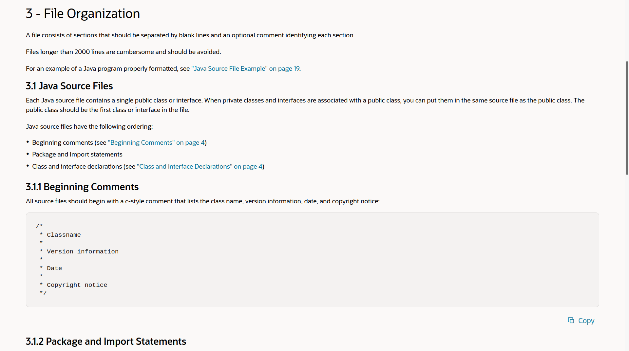
Original Java Coding Guidelines

Slide 28
Categories and Examples of Method Types
Query Method | Mutation Method | Helper Method
get method (getter) | set method (setter) | factory method
boolean query method | command method | cloning method
comparison method | initialization method | assertion method
conversion method | finalization method | logging method
... | ... | ...

Slide 29
Conventions / Patterns Beyond Formatting
Naming conventions
  Attributes, methods
  Classes, packages
  ...
Design conventions
  Collaborations
  Modules, classes
  ...
Package structures
  …
See our Advanced Design and Programming (ADAP) course

Slide 30
Quiz: Software Development
A file may have many authors. Should the names of these authors be listed in the file’s header?
  Yes
  No

Slide 31
6. Technical Debt

Slide 32
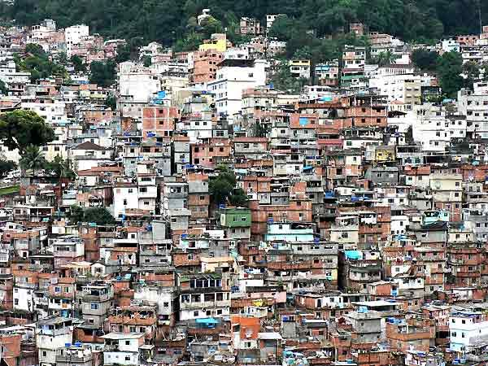

Slide 33
Definition of Big Ball of Mud [FY97]
A Big Ball of Mud is a haphazardly structured, sprawling, sloppy, duct-tape-and-baling-wire, spaghetti-code jungle. These systems show unmistakable signs of unregulated growth, and repeated, expedient repair. Information is shared promiscuously among distant elements of the system, often to the point where nearly all the important information becomes global or duplicated. The overall structure of the system may never have been well defined. If it was, it may have eroded beyond recognition. Programmers with a shred of architectural sensibility shun these quagmires. Only those who are unconcerned about architecture, and, perhaps, are comfortable with the inertia of the day-to-day chore of patching the holes in these failing dikes, are content to work on such systems.

Slide 34
Benefits of Good (“Well-Factored”) Code
Maintainability
(Easier to understand)
Extensibility
(Easier to adapt and evolve)
Predictability
(Improves planning ability)

Slide 35
Video on Technical Debt [1]
Technical Debt
(Ward Cunningham)
[1] See https://youtu.be/Jp5japiHAs4

Slide 36
Video Lessons
Technical debt is a metaphor
  Communicates well to manager
  (Certainly in financial services)
Taking on debt can speed up development
  It may be justified to learn faster
  But you have to pay up later
If you don’t pay back debt you’ll slow down
  Paying up means refactoring
  Still, never write poor code deliberately

Slide 37
Handling Technical Debt
Identify problem
(So-called “code smells”)
Identify need to act
(Correlate occurrences)
Know how to act
(Refactor code)

Slide 38
Code Smell
According to Fowler [F99]
  “smells are certain structures in the code that indicate violation of fundamental design principles and negatively impact design quality”
  also, “a code smell is a surface indication that usually corresponds to a deeper problem in the system”
Code smells are not bugs

Slide 39
Example Code Smells
Duplicated code
Long method
Large class
...

Slide 40
7. Refactoring

Slide 41
Refactoring (Practice)
Definition and purpose
  Is a behavior-preserving transformation of existing source code
  It is a change made to the internal structure of software to make it easier to understand and cheaper to modify without changing its observable behavior
More on refactoring
  Change the structure of code without changing behavior
  Focus on non-functional features within range of specification
  Are defined techniques that are typically language specific
  Are ideally supported by IDEs, for example, the Eclipse JDT
Defined by Opdyke [O92], popularized by Fowler [F99]

Slide 42
Example Refactorings
Rename class
Pull-up field
Extract method
…
More at https://refactoring.com

Slide 43
Example Extract-Method Refactoring 1 / 2
public class PhotoManager extends ObjectManager {
protected Map<PhotoId, Photo> allPhotos = new HashMap<PhotoId, Photo>();
public void addPhoto(Photo photo) {
PhotoId id = photo.getId();
assertIsNewPhoto(id);
allPhotos.put(id, photo);
...
}
public Photo getPhotoFromId(PhotoId id) {
Photo result = doGetPhotoFromId(id);
if (result == null) {
...
if (result != null) { allPhotos.put(id, result); }
}
return result;
}
public Set<Photo> findPhotosByOwner(String ownerName) {
...
for (Iterator<Photo> i = r.iterator(); i.hasNext();) {
Photo photo = i.next();
allPhotos.put(photo.getId(), photo);
}
return r;
}
...

Slide 44
Example Extract-Method Refactoring 2 / 2
public class PhotoManager extends ObjectManager {
public void addPhoto(Photo photo) {
...
doAddPhoto(photo);
...
}
public Photo getPhotoFromId(PhotoId id) {
...
doAddPhoto(photo);
...
}
public Set<Photo> findPhotosByOwner(String ownerName) {
...
for (Iterator<Photo> i=r.iterator(); i.hasNext(); ) {
doAddPhoto(i.next());
}
...
}
protected void doAddPhoto(Photo myPhoto) {
allPhotos.put(myPhoto.getId(), myPhoto);
}
...

Slide 45
When to Refactor?
The “three strikes” rule
1st time: Just do it
2nd time: Wince at duplication
3rd time: Refactor

Slide 46
Refactoring Process (Two Hats)
code smells
Add Function
Refactor
code does not
smell anymore

Slide 47
Code Smells and Refactorings
Duplicated code
Extract method
Long method
Pull up field
Large class
Form template method
...
Decompose conditional
Extract class
Extract subclass
Extract interface
...

Slide 48
Example Refactoring Process
The refactoring process can become complex
  It may turn into a series of refactorings
Example removal of switch statement
  Extract method
  Move method
  Replace type code …
    with subclass or
    with state / strategy object
  Replace conditional ...
    with polymorphism

Slide 49
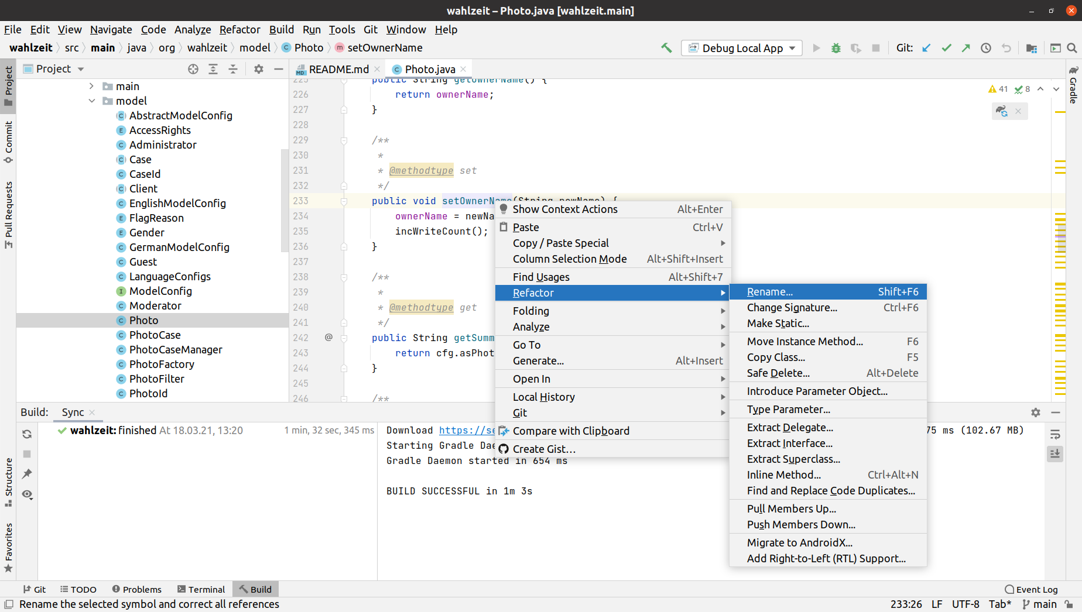

Slide 50
Quiz on Refactoring
Your code smells. All signs for refactoring are given. Under which circumstances should you not start a refactoring?
Notes:
The code will be abandoned (no business value in refactoring)
You are already in the middle of a refactoring---finish that first

Slide 51
Summary
Software developer
Sprint planning
Day planning
Programming principles
Code ownership
Technical debt
Refactoring

Slide 52
Thank you! Questions?
dirk.riehle@fau.de – https://oss.cs.fau.dedirk@riehle.org – https://dirkriehle.com – @dirkriehle
DR

Slide 53
Legal Notices
License
  Licensed under the CC BY 4.0 International license
Copyright
  © 2010-2022 Dirk Riehle, some rights reserved

